Slide 1
Racial and Ethnic Disparities in Cancer Mortality Outcomes: The Influences of Sociodemographic, Clinicopathologic, and Treatment Factors
Olajumoke Olateju, Douglas J. Thornton
APHA Conference 2024
Poster Presentation Supplement

Slide 2
Select Patient Characteristics – NSCLC
 | White | Black | Hispanic | AANHPI
n (%) | 14,285 (72.33) | 2,519 (12.76) | 2,326 (11.78) | 619 (3.13)
Age at diagnosis (Yrs., Median, Q1-Q3) | 70 (62-76) | 66 (59-72) | 68 (61-75) | 66 (58-73)
Metastatic stage at diagnosis | 40.38 | 47.04 | 48.11 | 56.06
Adenocarcinoma | 43.16 | 47.33 | 46.98 | 65.17
Time to treatment initiation (days) | 35 (30-38) | 44 (40-49) | 38 (31-42) | 38 (32-42)
First line of treatment
Surgery | 32.31 | 24.10 | 28.46 | 26.98
Chemotherapy | 43.57 | 50.06 | 47.64 | 52.83
Immunotherapy | 6.03 | 6.43 | 6.92 | 8.24
Radiation therapy | 39.83 | 43.07 | 35.04 | 36.03
Comorbidities (≥2) | 4.72 | 6.19 | 4.34 | 2.59
Current smoker | 27.00 | 32.51 | 23.52 | 13.09
Insurance
Uninsured | 3.77 | 6.83 | 10.19 | 10.82
Medicaid | 2.67 | 7.30 | 5.42 | 3.23
Census tract poverty level (≥20%) | 17.27 | 48.63 | 46.60 | 16.80
County level median income (≥$63,511) | 28.10 | 19.17 | 13.46 | 38.45
*Characteristics are reported in percentage, unless otherwise indicated; adenocarcinoma is a histologic subtype of NSCLC

Slide 3
Select Patient Characteristics – SCLC
 | White | Black | Hispanic | AANHPI
n (%) | 2,437 (78.18) | 291 (9.34) | 339 (10.88) | 50 (1.60)
Age at diagnosis (Yrs., Median, Q1-Q3) | 68 (61-74) | 66 (59-71) | 67 (60-74) | 67 (63-74)
Metastatic stage at diagnosis | 66.56 | 66.67 | 69.03 | 66.00
Time to treatment initiation (days) | 21 (17-25) | 24 (15-33) | 17 (9-32) | 19 (0-31)
First line of treatment
Surgery | 4.31 | 2.06 | 2.650 | 2.00
Chemotherapy | 82.77 | 82.82 | 83.19 | 80.00
Radiation therapy | 41.85 | 47.08 | 41.00 | 46.00
Comorbidities (≥2) | 6.36 | 5.16 | 4.71 | 4.00
Current smoker | 40.38 | 36.77 | 41.59 | 32.00
Insurance
Uninsured | 6.11 | 11.00 | 12.39 | 16.00
Medicaid | 4.14 | 9.28 | 8.85 | 6.00
Census tract poverty level (≥20%) | 18.47 | 52.92 | 47.49 | 26.00
County level median income (≥$63,511) | 26.92 | 17.53 | 9.44 | 22.00
*Characteristics are reported in percentage, unless otherwise indicated

Slide 4
Select Patient Characteristics – Melanoma
 | White | Black | Hispanic | AANHPI
n (%) | 6,307 (91.49) | 50 (0.73) | 481 (6.98) | 56 (0.81)
Age at diagnosis (yrs., median, Q1-Q3) | 63 (54-72) | 60 (52-67) | 60 (52-67) | 60 (52-68)
Metastatic stage at diagnosis | 6.87 | 30.00 | 16.01 | 7.14
Acral Lentiginous melanoma | 0.97 | 18.00 | 9.74 | 7.14
Time to treatment initiation (days) | 14 (7-21) | 33 (20-45) | 22 (18-25) | 8 (5-13)
First line of treatment
Surgery | 94.36 | 88.00 | 89.19 | 96.43
Chemotherapy | 2.95 | 4.00 | 4.99 | 7.14
Immunotherapy | 6.82 | 22.00 | 13.72 | 7.14
Radiation therapy | 3.60 | 4.00 | 7.28 | 3.57
Comorbidities (≥2) | 1.41 | 4.00 | 1.66 | 1.79
Insurance
Uninsured | 2.74 | 6.00 | 14.35 | 7.14
Medicaid | 1.11 | 4.00 | 3.53 | 0.00
Census tract poverty level (≥20%) | 11.61 | 30.00 | 40.33 | 5.36
County level median income (≥$63,511) | 36.72 | 26.00 | 18.30 | 39.29
*Characteristics are reported in percentage, unless otherwise indicated
Acral lentiginous melanoma is a histologic subtype of melanoma

Slide 5
Select Patient Characteristics – Colorectal Cancer
 | White | Black | Hispanic | AANHPI
n (%) | 14,576 (58.70) | 3,213 (12.94) | 6,292 (25.34) | 729 (3.02)
Age at diagnosis (Yrs., Median, Q1-Q3) | 66 (57-75) | 61 (53-70) | 61 (53-71) | 61 (52-71)
Metastatic stage at diagnosis (n, %) | 18.59 | 23.17 | 21.74 | 22.63
Time to treatment initiation (days) | 20 (18-23) | 24 (20-28) | 23 (20-27) | 25 (19-29)
First line of treatment
Surgery | 86.74 | 83.15 | 84.22 | 82.58
Chemotherapy | 36.00 | 37.31 | 41.25 | 40.60
Immunotherapy | 4.79 | 5.40 | 4.18 | 6.17
Radiation therapy | 12.86 | 9.17 | 14.01 | 14.54
Comorbidities (≥2) | 2.72 | 3.78 | 2.59 | 1.23
Site
Colon | 54.99 | 58.76 | 55.12 | 54.92
Rectum | 30.39 | 26.36 | 31.91 | 35.37
Insurance
Uninsured | 4.40 | 10.53 | 15.06 | 14.81
Medicaid | 1.88 | 5.53 | 6.16 | 2.88
Census tract poverty level (≥20%) | 16.10 | 45.55 | 49.41 | 18.79
County level median income (≥$63,511) | 30.46 | 21.42 | 12.57 | 41.43
*Characteristics are reported in percentage, unless otherwise indicated

Slide 6
Select Patient Characteristics – Prostate Cancer
 | White | Black | Hispanic | AANHPI
n (%) | 14,489 (63.02) | 3,886 (16.81%) | 4,048 (17.61%) | 589 (2.56%)
Age at diagnosis (Yrs., Median, Q1-Q3) | 66 (61-72) | 63 (57-68) | 66 (60-71) | 66 (61-72)
Metastatic stage at diagnosis | 8.13 | 10.48 | 11.44 | 9.34
Time to treatment initiation (days) | 64 (28-92) | 73 (30-92) | 64 (28-91) | 65 (30-92)
First line of treatment
Surgery | 89.75 | 79.79 | 85.91 | 84.96
Chemotherapy | 30.85 | 46.02 | 43.38 | 40.11
Immunotherapy | 5.16 | 6.50 | 7.04 | 8.57
Radiation therapy | 21.17 | 21.02 | 19.90 | 21.70
Hormone therapy | 32.68 | 28.41 | 29.46 | 35.22
Comorbidities (≥2) | 1.72 | 3.05 | 1.70 | 0.91
Insurance
Uninsured | 2.27 | 8.11 | 13.51 | 9.92
Medicaid | 3.30 | 8.90 | 10.90 | 4.70
Census tract poverty level (≥20%) | 14.57 | 41.89 | 46.34 | 13.15
County level median income (≥$63,511) | 34.76 | 25.74 | 14.61 | 42.97
*Characteristics are reported in percentage, unless otherwise indicated

Slide 7
Select Patient Characteristics – Breast Cancer
 | White | Black | Hispanic | AANHPI
n (%) | 82,630 (61.96) | 15,747 (11.81%) | 30,242 (22.68%) | 4,747 (3.56%)
Age at diagnosis (Yrs., Median, Q1-Q3) | 64 (54-72) | 58 (49-67) | 58 (48-67) | 55 (46-65)
Metastatic stage at diagnosis* | 1.34 | 2.45 | 1.87 | 1.96
HER2 status (negative) | 18.52 | 18.76 | 18.84 | 22.67
ER positive | 18.62 | 16.29 | 18.76 | 23.38
PR positive | 16.36 | 13.53 | 16.26 | 20.77
Time to treatment initiation (days) | 32 (29-35) | 40 (38-43) | 38 (31-45) | 35 (30-37)
First line of treatment
Surgery | 89.75 | 79.79 | 85.91 | 84.96
Chemotherapy | 30.85 | 46.02 | 43.38 | 40.11
Immunotherapy | 5.16 | 6.50 | 7.04 | 8.57
Radiation therapy | 21.17 | 21.02 | 19.90 | 21.70
Hormone therapy | 32.68 | 28.41 | 29.46 | 35.22
Comorbidities (≥2) | 1.72 | 3.05 | 1.70 | 0.91
Insurance (%)
Uninsured | 2.27 | 8.11 | 13.51 | 9.92
Medicaid | 3.30 | 8.90 | 10.90 | 4.70
Census tract poverty level (≥20%) | 14.57 | 41.89 | 46.34 | 13.15
County level median income (≥$63,511) | 34.76 | 25.74 | 14.61 | 42.97
*Characteristics are reported in percentage, unless otherwise indicated; HER = human epidermal growth factor receptor 2; PR = progesterone receptor; ER = estrogen receptor
*The true proportion of stage and hormone receptor status classifications are unknown due to missingness of data, hence the need for an “unknown” category

Slide 8
Crude Mortality Rates

Slide 9
Crude Mortality Rates..

Slide 10
Mortality Risk by Race and Cancer Site (CSS)

Slide 11
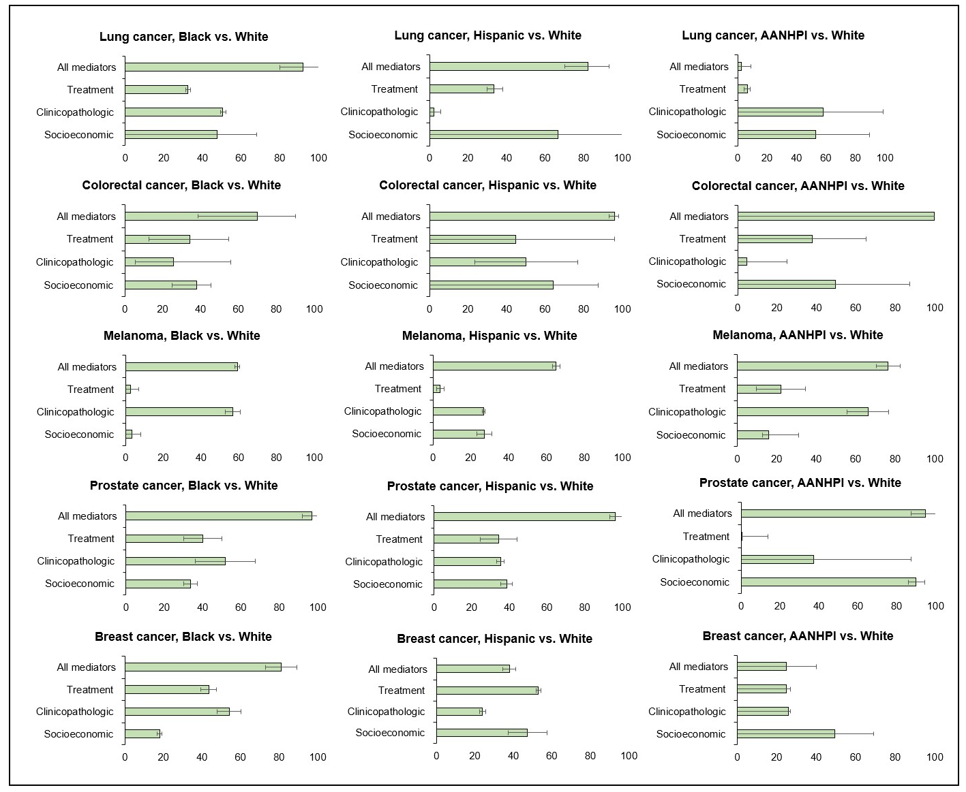
Percent Contribution of Candidate Mediators (CSS)
Mediating effects of socioeconomic and clinicopathological factors were most prominent, especially for Black patients

Slide 12
References
Siegel RL, Miller KD, Wagle NS, Jemal A. Cancer statistics, 2023. CA Cancer J Clin. 2023 Jan;73(1):17-48. doi: 10.3322/caac.21763. PMID: 36633525.
O'Keefe EB, Meltzer JP, Bethea TN. Health disparities and cancer: racial disparities in cancer mortality in the United States, 2000-2010. Front Public Health. 2015 Apr 15;3:51. doi: 10.3389/fpubh.2015.00051. PMID: 25932459; PMCID: PMC4398881.
Minas TZ, Kiely M, Ajao A, Ambs S. An overview of cancer health disparities: new approaches and insights and why they matter. Carcinogenesis. 2021 Feb 11;42(1):2-13; Osarogiagbon RU, Sineshaw HM, Unger JM, Acuña-Villaorduña A, Goel S. Immune-Based Cancer Treatment: Addressing Disparities in Access and Outcomes. Am Soc Clin Oncol Educ Book. 2021 Mar;41:1-13..
VanderWeele TJ, Vansteelandt S. Mediation Analysis with Multiple Mediators. Epidemiol Methods. 2014 Jan;2(1):95-115. Karia PS, Huang Y, Tehranifar P, Wright JD, Genkinger JM. Racial and ethnic differences in type II endometrial cancer mortality outcomes: The contribution of sociodemographic, clinicopathologic, and treatment factors. Gynecol Oncol. 2023 Jan;168:119-126.
Chitnis AS, Aparasu RR, Chen H, Johnson ML. Effect of certain angiotensin-converting enzyme inhibitors on mortality in heart failure: a multiple-propensity analysis. Res Social Adm Pharm. 2012 Mar-Apr;8(2):145-56. Bergstra SA, Sepriano A, Ramiro S, et alThree handy tips and a practical guide to improve your propensity score modelsRMD Open 2019;5:e000953. doi: 10.1136/rmdopen-2019-000953
Kollman C. Survival Analysis and the Immortal Time Bias. JAMA Ophthalmol. 2018;136(11):1314–1315. doi:10.1001/jamaophthalmol.2018.3499

